Slide 1

Department of Computer Science and Engineering 22.12.2022
Design and Development of Deep-Learning Enabled Audio Spoof Detector
Reg .No. | Name of the student
1905015 | Gourav Gopal
1905031 | Nalin Suriya S
1905060 | Vishal Karthik S
1905062 | Yokesh R S
Guided By:
Dr.M. Mohanapriya M.E., Ph.D.
Associate Professor,
Department of CSE,
Coimbatore Institute of Technology,
Coimbatore

Slide 2
Problem Statement
The increase in the advancement of audio editing softwares provide an easy way to the accessibility of voice-controlled authentication systems which makes the voice-controlled devices(VCD) vulnerable for audio spoof attacks.
Audio spoof attack is the manipulation of genuine signal through recording or modifying to trick an audio verification system.
Hence, there is a necessity to create audio spoof detector.

Slide 3
Objective
To develop a Deep-Learning Enabled Audio Spoof Detector which uses Recurrent Neural Networks(RNN) and Long Short Term Memory(LSTM) to classify human voice from recorded voices.
The proposed system will defend from the following attacks:
Replay attack
Voice conversion attack

Slide 4
Abstract
Authentication has become very important aspect of our day today lives starting from normal lock screen pin to human retina based authentication systems.
One among those popular and complex authentication systems are the audio based authentication systems where in people use certain words to unlock devices and objects like mobiles, doors etc.,
Audio Authentication generally involves authentication based on words and voices.

Slide 5
Abstract
Issue in the existing system is that the system verifies and extracts the features of words and voices but it does not classify human voice and recorded human voices.
The above issue can be overcome by using models like RNN and LSTM for classification.

Slide 6

Introduction
Development of VCD’s, have boosted the realization of smart homes, voice-controlled authentication systems etc.,.
These VCDs are vulnerable to different spoofing attacks .

Slide 7
Introduction
Audio Authentication is becoming very essential part of our lives. Audio Authentication spoofing is becoming an issue.
High-quality audio recorders enables bypassing this audio authentication system by just recording the human voice and reusing them for accessing the same system.
Thus, there exists a need to develop a voice anti-spoofing framework capable of detecting multiple audio spoofing attacks.

Slide 8
Literature Survey

Slide 9
Title of Paper | Methodology or Algorithms used | Advantages or Disadvantages
1. Fusion of BiLSTM and GMM-UBM Systems for Audio Spoofing Detection, International Journal of Advanced Trends in Computer Science and Engineering , 2019 | Anti-spoofing system using constant Q cepstral coefficients (QFCC) features and BiLSTM networks for genuine/spoof audio classification. Fusion of BiLSTM and Gaussian Mixture Model (GMM) – Universal Background Model (UBM) system to improve results. | Uses time domain dependency relation in audio and gives better results. Uses fusion mechanism to improve accuracy. It doesn’t provide classification model for classification of various attacks.
2. Improving anti-spoofing with octave spectrum and short-term spectral statistics information, Applied Acoustics – Elsevier Limited, 2020 | To combine linear power spectrum and octave power spectrum and to produce a n-hypothesis which utilizes the complementary information obtained from octave power spectrum to linear power spectrum. CNN, RNN, ResNet, GMM, DNN are the algorithms used. | The system combines linear power spectrum and octave power spectrum to form better novel feature eCQCC which produces good results. Works for Synthetic and Playback spoof attacks. Does not prove to be much effective in classification of audio spoofed data.

Slide 10
Title of Paper | Methodology or Algorithms used | Advantages or Disadvantages
3. Spoofed Speech Detection with Weighted Phase Features and Convolutional Networks, Archives of Acoustics, 2022 | Frame-wise weighted magnitude spectrum for effective detection of replay attacks. Frame-wise weighted cosine normalized phase features as feature extraction. CNN classifier to detect spoofing attacks using the extracted features. CNN, DNN, GMM are the algorithms used. | Frame-wise weighted magnitude spectrum results in more effective method for spoof detection. Discusses various attacks like Synthetic attacks, Replay attacks and S10. Takes too much computational cost for training.
4. Detection of Various Speech Forgery Operations Based on Recurrent Neural Network, Springer Nature Singapore PVT LTD, 2020 | SpoofForensic method based on RNN for the detection of various audio forgery operations. The model is trained using the TIMIT and UME datasets and intra-database evaluation and cross-based evaluation is done. Feature extraction techniques like MFCC and LFCC are used. | Feature extraction techniques like MFCC and LFCC are used to extract audio features. RNN is used as it can capture the correlation between the frames in a speech recognition application. So, it is considered better than CNN. The cross-database evaluation accuracy could be improved.

Slide 11
Title of Paper | Methodology or Algorithms used | Advantages or Disadvantages
5. Fake Audio Speech Detection, International Journal of Innovative Research in Technology, 2020 | A model is built to identify whether an audio is real or not. Uses visual representations of audio clips in the model known as spectrograms, ie raw audio is converted into mel-frequency spectrograms. Deep learning models and python libraries like Numpy, Pandas and Librosa are used. Sigmoid activation function which gives 1 for real voice and 0 for fake voice. | The real and fake voices can be differentiated. The accuracies obtained for training, validation are considerably high ( 99% and 95% respectively). This work only focuses on deep fake audio forgery and it doesn’t detect or identify other audio forgery operations. The testing accuracy could be improved (85%).
6. Deep Learning based DFWF Model for Audio Spoofing Attack Detection, Journal of Artificial Intelligence and Capsule Networks, 2020 | Continuous learning using dynamic neural network based on DWDF method. Positive sample alignment (PSA) and learning without forgetting (LwF). Knowledge distillation loss to retain memory loss. | Overcomes the demerit of loss of previous data by the introduction of Knowledge Distillation Loss. Poor performance in detection of unseen data. Requires both original and new data. Storage of data is not proper.

Slide 12
Title of Paper | Methodology or Algorithms used | Advantages or Disadvantages
7. Voice spoofing countermeasure for voice replay attacks using deep learning, Journal of Cloud Computing : Advances, Systems and applications, 2022 | Audio signals are decomposed and two features of 7, 7-dim, ie MFCCs and GTCCs are obtained. BiLSTM network is used as a deep learning classifier. | Avoids replay attacks in ASV. Voice biometrics. More accurate with the method of speech decomposition. Does not discuss about many audio spoof attacks, focuses mainly on replay attacks only.
8. LSTM and CNN based ensemble approach for spoof detection task in automatic speaker verification systems, Journal of Ambient Intelligence and Humanized Computing, 2022 | Audio spoof detection which uses deep learning algorithms to detect various attacks created by synthesis or conversion of speech. ASV spoof dataset 2015,2019 is used. Feature extraction techniques used are – MFCC, inverse MFCC, constant Q cepstral coefficients. RNN, LSTM, spatial CNN, temporal convolution CNN are the algorithms used. Ensemble method is used. | Various feature extraction techniques are used which extracts audio quality features. LSTM models increases performance. Ensemble method is used to get a consolidated decision from models. Performance on combined dataset is low. Deep CNN can be used to improve performance.

Slide 13
Project Modules
Module 1:
Data collection- ASV spoof Dataset collection and Dataset Loading.
Module 2:
Data visualization.
Data pre-processing.
Feature extraction.

Slide 14
Project Modules
Module 3:
Creation of Deep learning models based on RNN,
LSTM.
Audio classification using RNN and LSTM is to be done and comparison of models to be performed.
Module 4:
Parameter Tuning - Trying out different parameters like activation functions, pooling methods and features to improve performance.
Ensemble methods - Usage of ensemble methods to further improve performance.

Slide 15
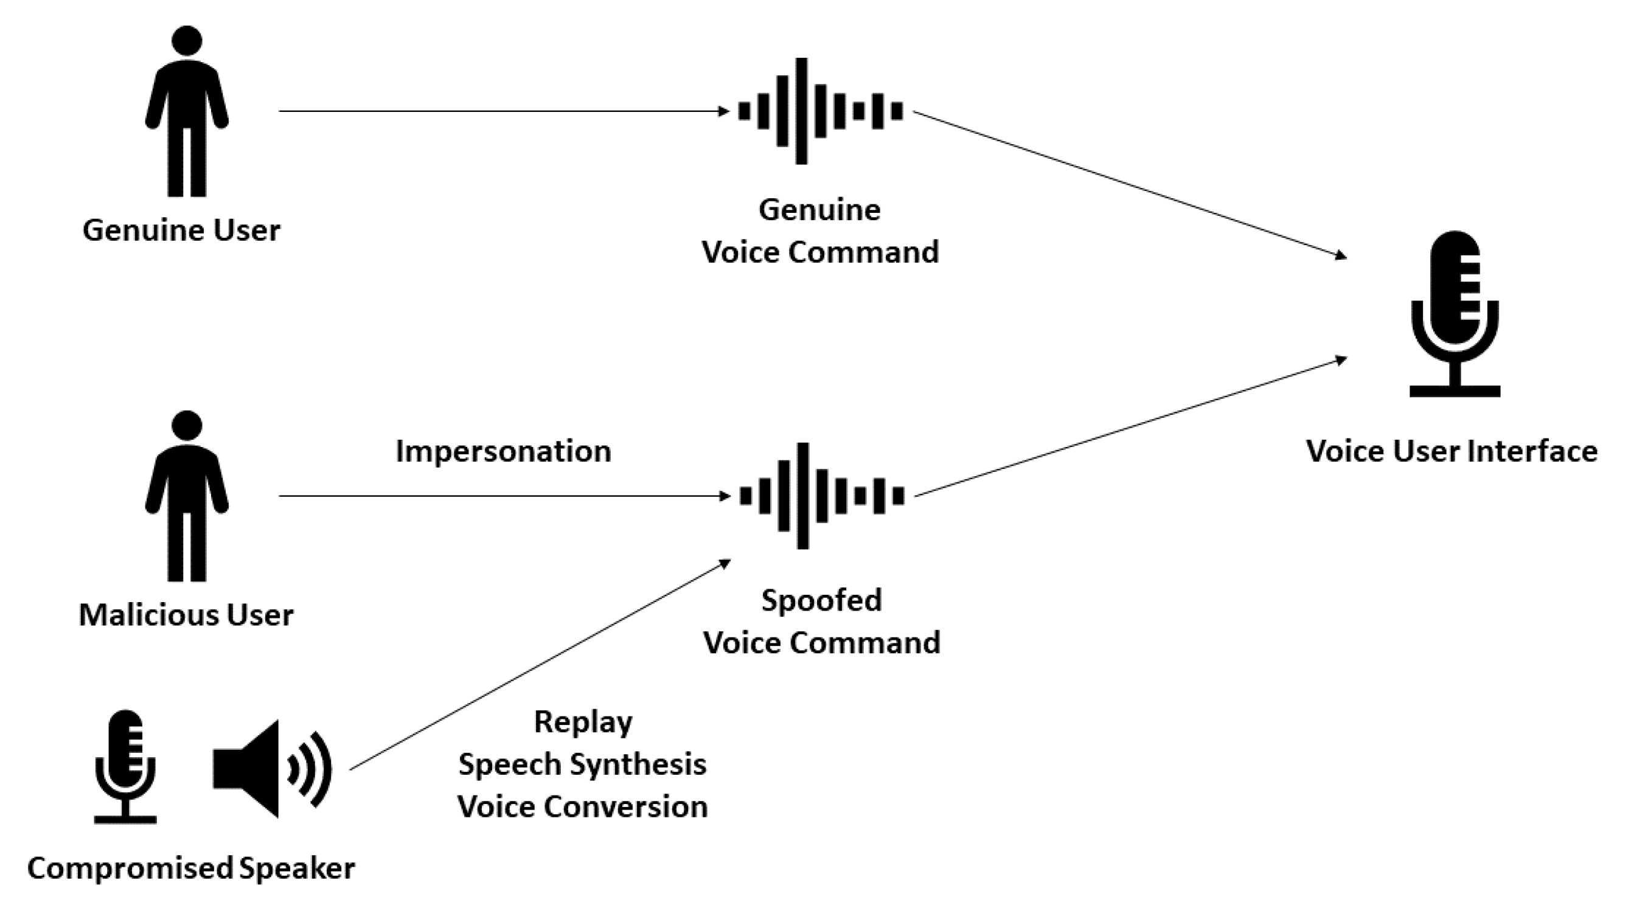

Project Modules
Module 5:
Integration to an IOT system and using it as an audio verification system.
Genuine

Slide 16
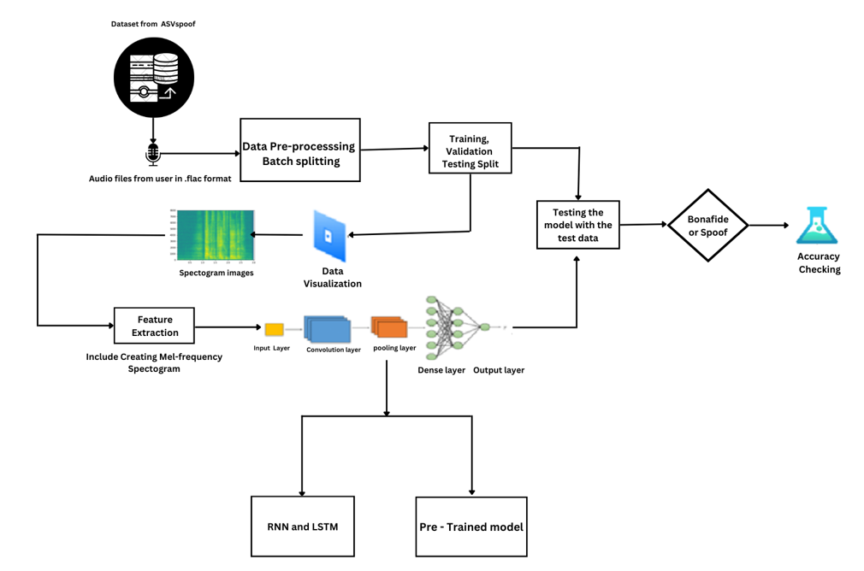
Architecture

Slide 17
Dataset
ASV SPOOF DATASET-2019
ASV Spoof dataset contains two types of Audio files
Physical Access - Bonafide utterances are made in a real, physical space in which spoofing attacks are captured and then replayed within the same physical space using replay devices of varying quality.
Logical Access - Bonafide and spoofed utterances generated using text-to-speech (TTS) and voice conversion (VC) algorithms are communicated across telephony and VoIP networks with various coding and transmission effects.
Physical and Logical access has 50000 audio files that are recorded and classified into two classes
Bonafide
Spoofed

Slide 18
Dataset
The dataset includes genuine and spoofed speech from 20 speakers (8 male, 12 female).Each spoofed utterance is generated according to one of 2 voice conversion and 3 speech synthesis algorithms.
The voice conversion systems include those based on (i) neural-network-based and (ii)transfer-function-based methods.
The speech synthesis systems were implemented with (i) waveform concatenation, (ii) neural-network-based parametric speech synthesis using source-filter vocoders and (iii) neural-network-based parametric speech synthesis using Wavenet.

Slide 19
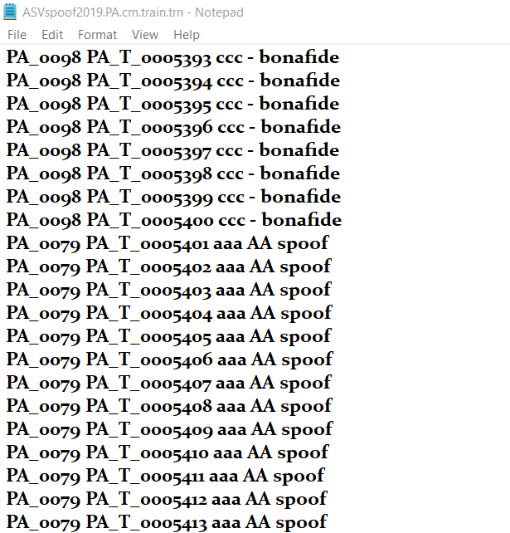
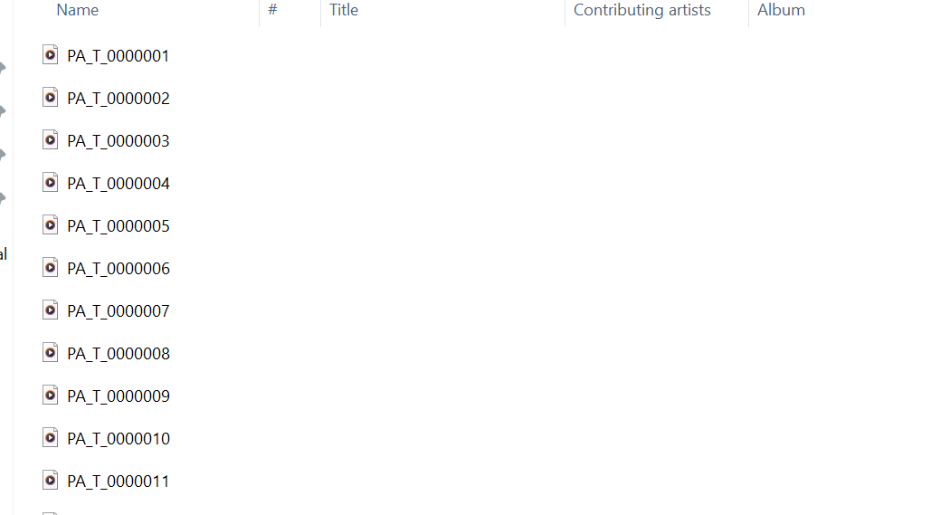
Dataset

Slide 20
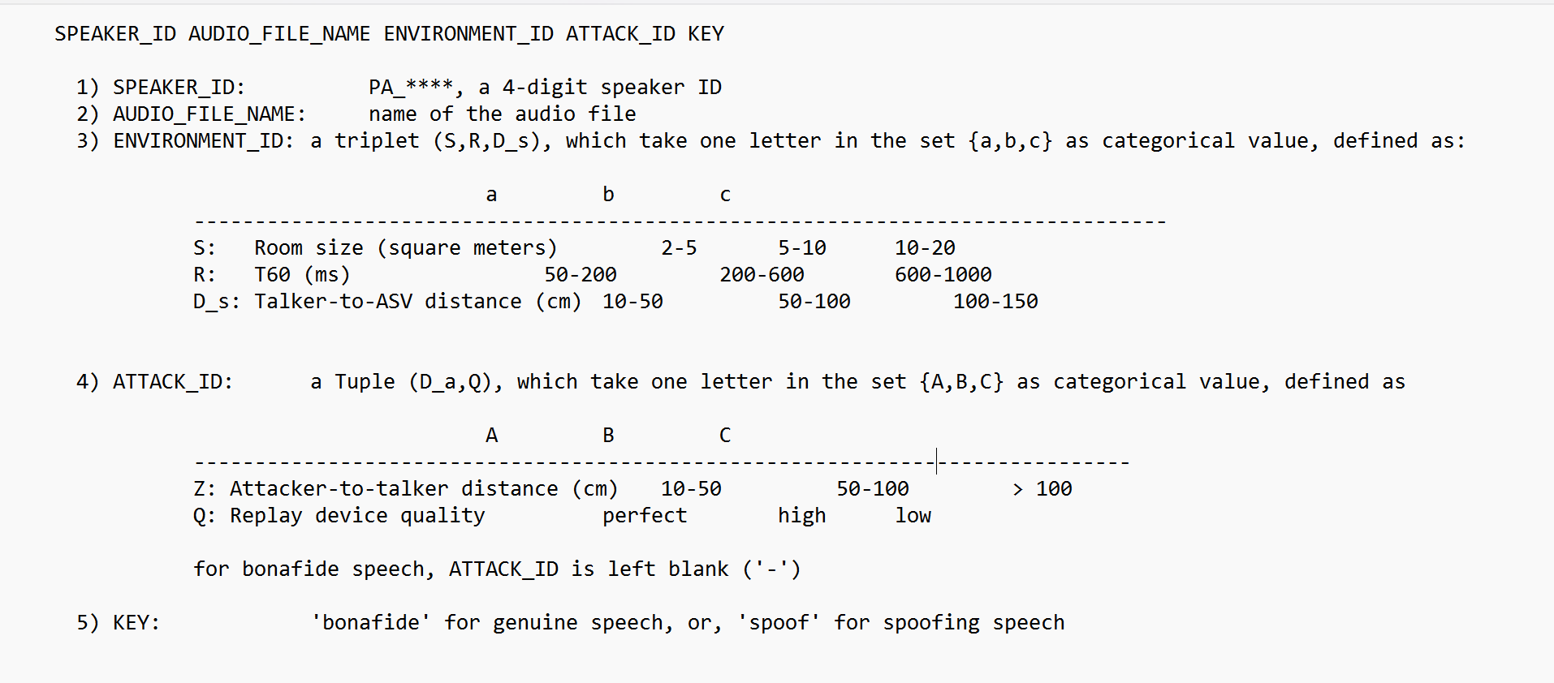
Dataset Description

Slide 21
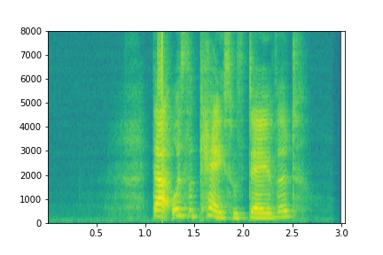
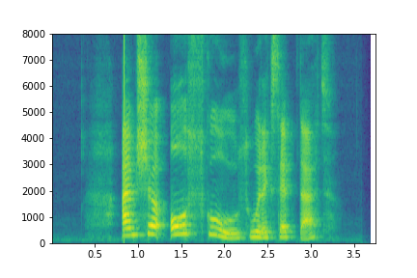
Spectrograms
Bonafide
Spoofed

Slide 22
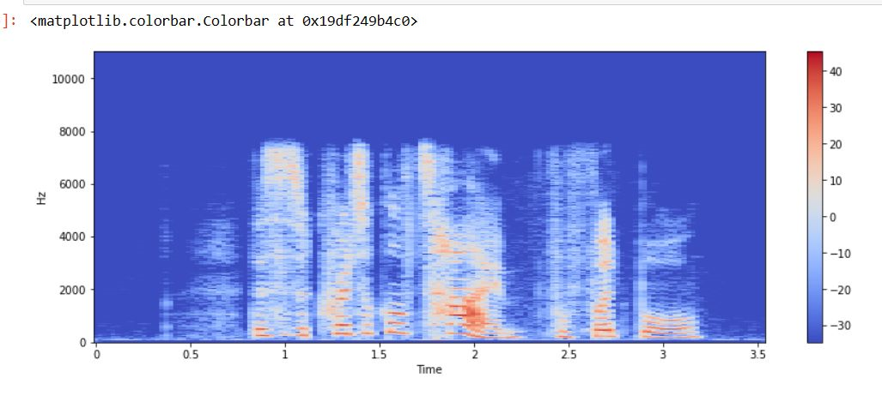
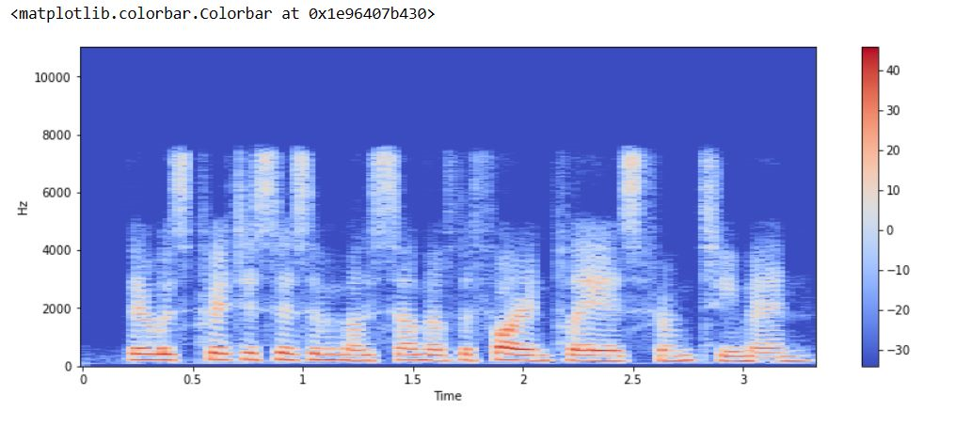
Visual Comparison between Authentic and Spoofed Audio Sample
Spectrogram:
Bonafide
Spoofed

Slide 23
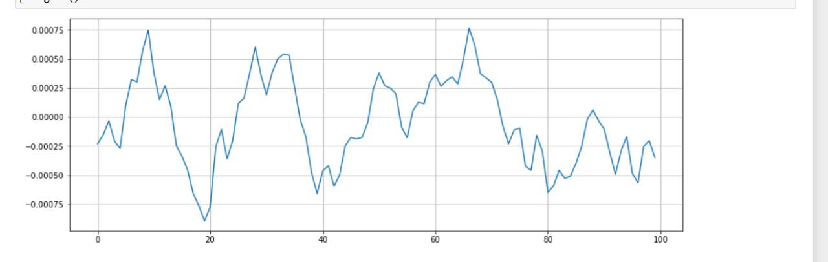
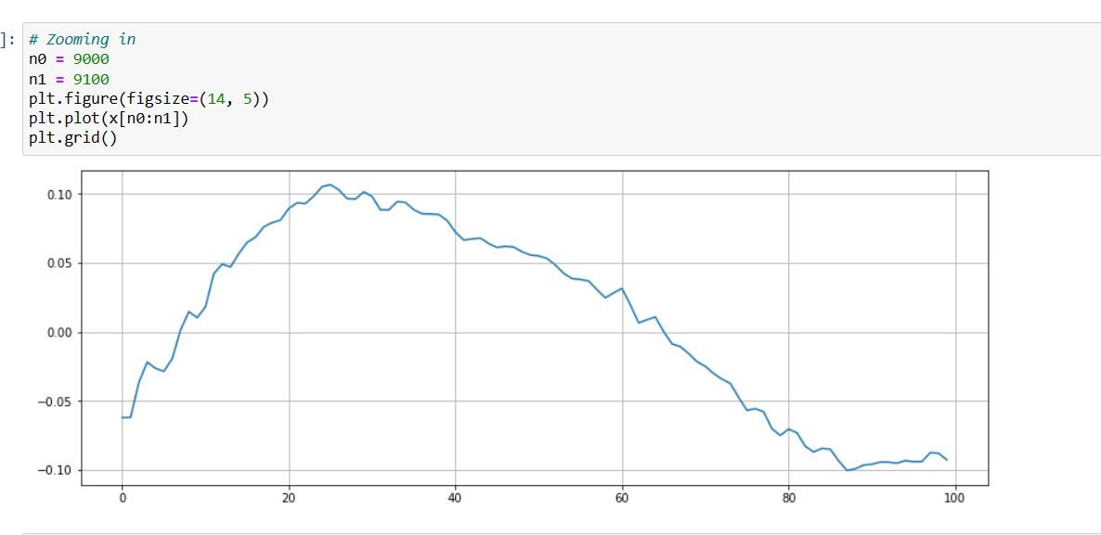
Visual Comparison between Authentic and Spoofed Audio Sample
Data Plot:
Bonafide
Spoofed

Slide 24
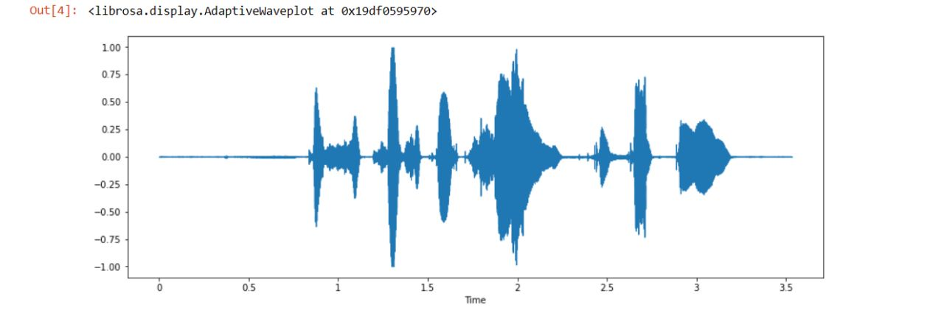
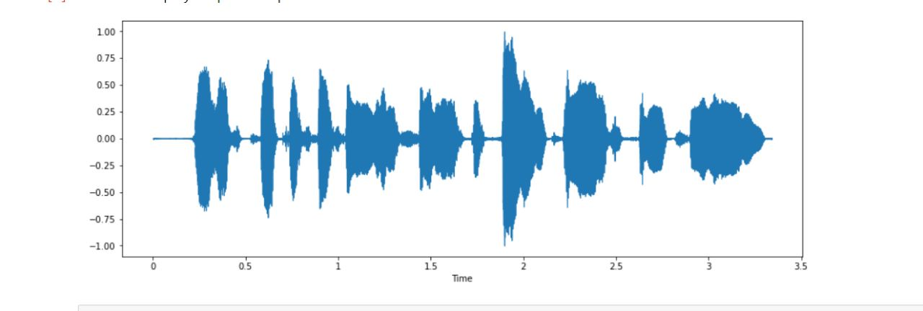
Visual Comparison between Authentic and Spoofed Audio Sample
Waveform:
Bonafide
Spoofed

Slide 25
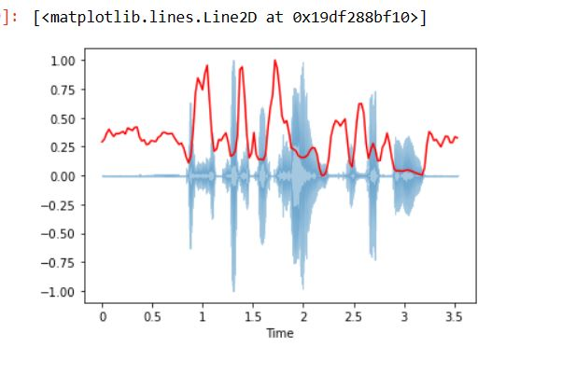
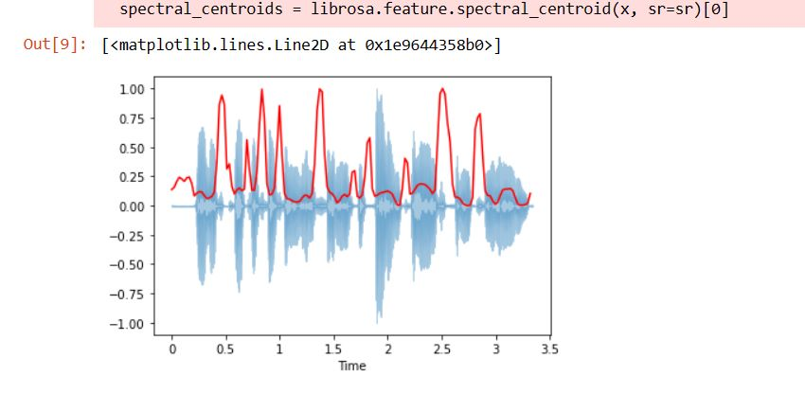
Visual Comparison between Authentic and Spoofed Audio Sample
Spectral Centroid:
Bonafide
Spoofed

Slide 26
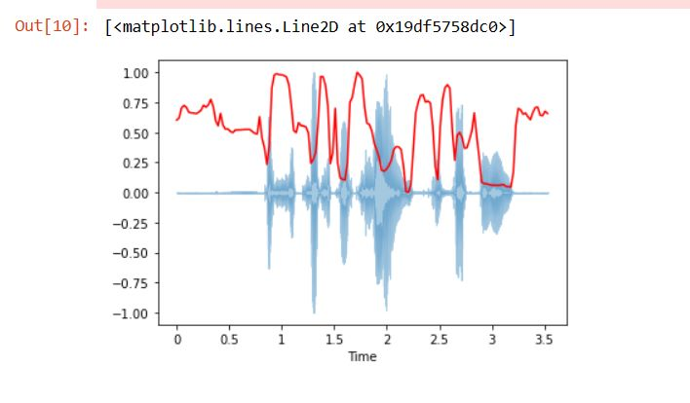
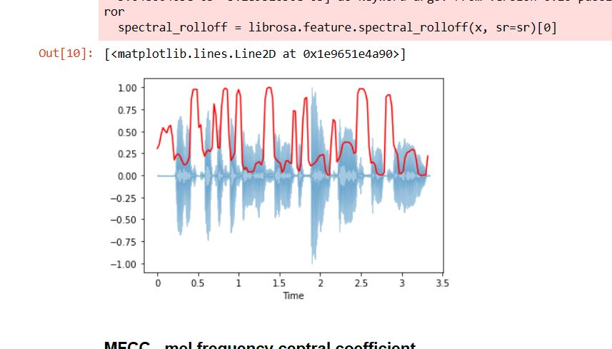
Visual Comparison between Authentic and Spoofed Audio Sample
Spectral Roll off:
Bonafide
Spoofed

Slide 27
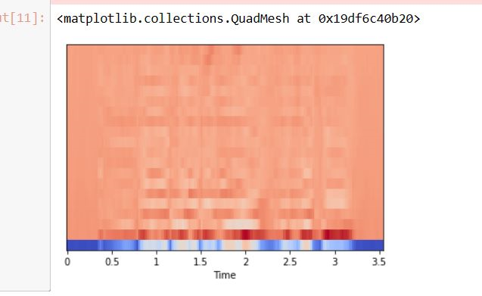
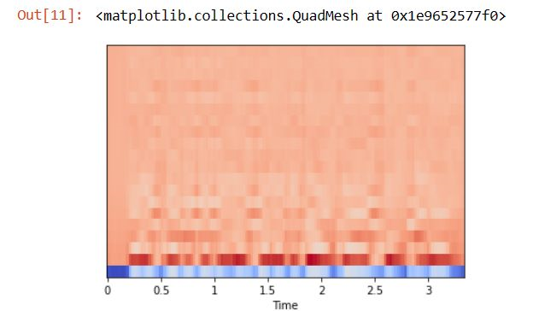
Visual Comparison between Authentic and Spoofed Audio Sample
MFCC:
Bonafide
Spoofed

Slide 28
Proposed Methodology
Audio files are visualized and converted as spectrograms.
With these spectrograms, the inputs are classified into actual voice and recorded voice.
The proposed system uses machine learning models such as LSTM and RNN.

Slide 29
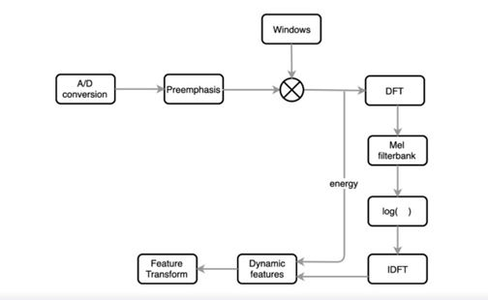
Algorithms used
Mel Frequency Cepstral Coefficients(MFCCs):
MFCC is the widely used technique for extracting the features from the audio signal.
Mel-frequency cepstral coefficients (MFCC) which have 39 features. The feature count is small enough to force us to learn the information of the audio. 12 parameters are related to the amplitude of frequencies. It provides us enough frequency channels to analyze the audio.

Slide 30
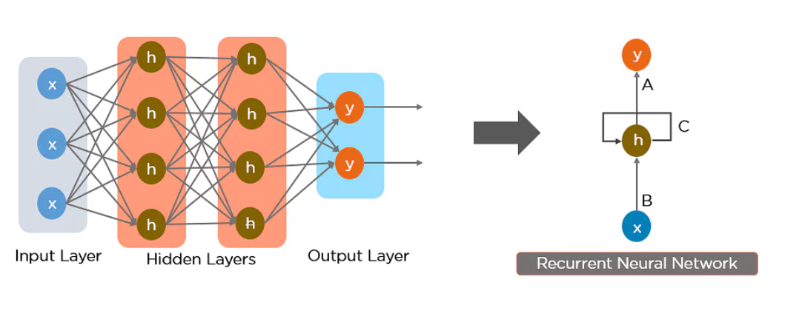
Algorithms used
Recurrent Neural Network (RNN):
RNN works on the principle of saving the output of a particular layer and feeding this back to the input in order to predict the output of the layer.

Slide 31
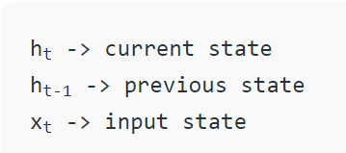
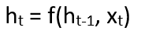
Algorithms used
RNN is proposed because normal feed forward neural network:
It cannot handle sequential data like audio files.
It cannot memorize previous inputs.
Formula for calculating current state:
Disadvantages:
Gradient vanishing and exploding problems.
Training an RNN is a very difficult task.
It cannot process very long sequences if using tanh or relu as an activation function.

Slide 32
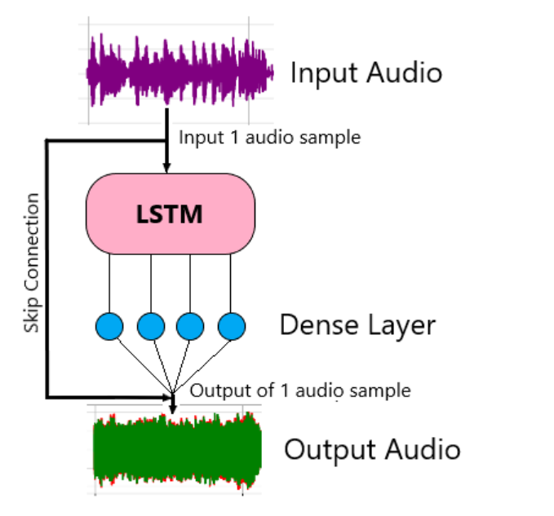
Algorithms used
Long Short Term Memory Networks (LSTM):
Long Short Term Memory networks(LSTM) – are a special kind of RNN, capable of learning long-term dependencies.
LSTMs provides a large range of parameters such as learning rates, and input and output biases. no need for fine adjustments. The complexity to update each weight is reduced to O(1) with LSTMs, similar to that of Back Propagation Through Time (BPTT), which is an advantage.

Slide 33
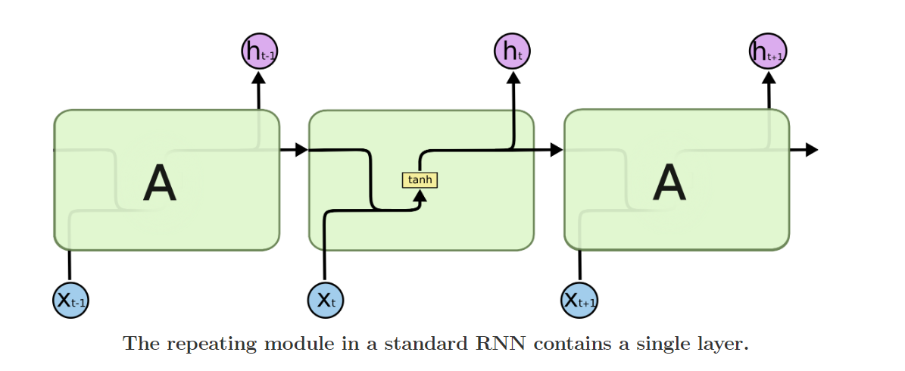
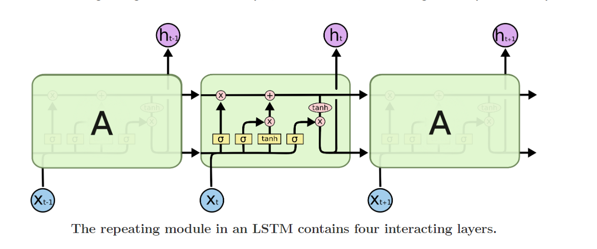

Slide 34
Algorithms used
BiDirectional LSTM:
Unlike standard LSTM, the input flows in both directions, and it’s capable of utilizing information from both sides. It’s also a powerful tool for modeling the sequential dependencies between words and phrases in both directions of the sequence.
BiLSTM adds one more LSTM layer, which reverses the direction of information flow.

Slide 35
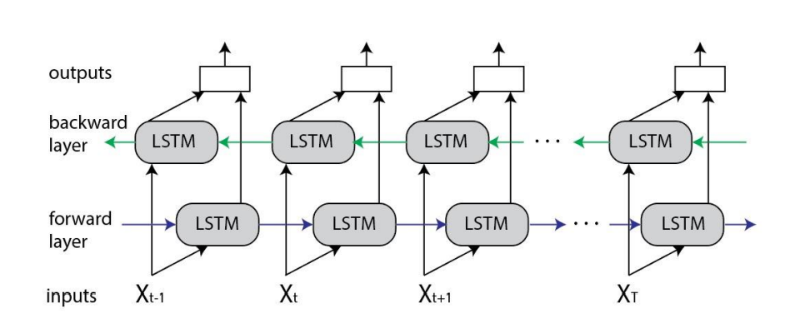

Slide 36
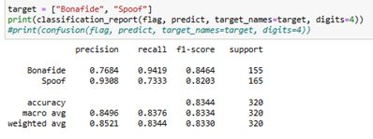
Results
Classification Report

Slide 37
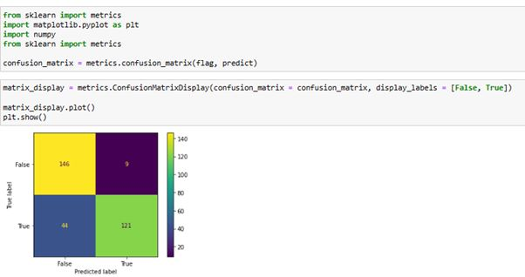
Results
Confusion Matrix

Slide 38
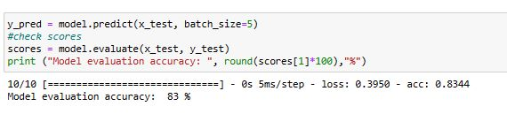
Results
Model testing

Slide 39
Conclusion
The proposed system can classify human voices from recorded voices.
The proposed system also defends from replay attacks and voice conversion attacks.
The accuracy obtained for the proposed system is 85%.

Slide 40
Future Works
The proposed system can be deployed and used alongside the audio authentication system to classify human voices from recorded voices.
The authentication system is used to authenticate the legitimate user.
The proposed system will be integrated into home automation IOT systems which contains voice-controllable features.

Slide 41
References
Dua, M., Jain, C. & Kumar, S. LSTM and CNN based ensemble approach for spoof detection task in automatic speaker verification systems. J Ambient Intell Human Comput 13, 1985–2000 (2022). https://doi.org/10.1007/s12652-021-02960-0
Yamagishi, Junichi; Todisco, Massimiliano; Sahidullah, Md; Delgado, Héctor; Wang, Xin; Evans, Nicolas; Kinnunen, Tomi; Lee, Kong Aik; Vestman, Ville; Nautsch, Andreas. (2019). ASVspoof 2019: The 3rd Automatic Speaker Verification Spoofing and Countermeasures Challenge database, [sound]. University of Edinburgh. The Centre for Speech Technology Research (CSTR). https://doi.org/10.7488/ds/2555.
https://www.simplilearn.com/tutorials/deep-learning-tutorial/rnn
https://colah.github.io/posts/2015-08-Understanding-LSTMs/
Sak, H., Senior, A.W., & Beaufays, F. (2014). Long short-term memory recurrent neural network architectures for large scale acoustic modeling. INTERSPEECH.
Ankur, Tanjemoon & Kundu, Bipasha & Foysal, Md & Ortiz, Bengie & Chong, Jo. (2022). LSTM-Based COVID-19 Detection Method Using Coughing. 10.21203/rs.3.rs-2106413/v1.
Akyol K, Şen B. Automatic Detection of Covid-19 with Bidirectional LSTM Network Using Deep Features Extracted from Chest X-ray Images. Interdiscip Sci. 2022 Mar;14(1):89-100. doi: 10.1007/s12539-021-00463-2. Epub 2021 Jul 27. PMID: 34313974; PMCID: PMC8313418.

Slide 42
References
Ivan Rakhmanenko Fusion of BiLSTM and GMM-UBM Systems for Audio Spoofing Detection August 2019 International Journal of Advanced Trends in Computer Science and Engineering 6(4):1741-1746.
Jichen Yang, Rohan Kumar Das,Improving anti-spoofing with octave spectrum and short-term spectral statistics information,Applied Acoustics,Volume 157,2020,107017,ISSN 0003-682X,
https://ijirt.org/master/publishedpaper/IJIRT149877_PAPER.pdf
Mittal, Aakshi & Dua, Mohit. (2022). Automatic speaker verification systems and spoof detection techniques: review and analysis. International Journal of Speech Technology. 25. 10.1007/s10772-021-09876-2.
https://irojournals.com/aicn/article/pdf/4/3/4
https://journals.pan.pl/dlibra/publication/141648/edition/123487/content/archives-of-acoustics-2022-vol-47-no-2-spoofed-speech-detection-with-weighted-phase-features-and-convolutional-networks-br-disken-gokay?language=en
Zhou, J., Hai, T., Jawawi, D.N.A. et al. Voice spoofing countermeasure for voice replay attacks using deep learning. J Cloud Comp 11, 51 (2022). https://doi.org/10.1186/s13677-022-00306-5

Slide 43
Thank you!

